Slide 1

Web Blogging Data
Initial prototyping and opportunity discovery for marketing teams.
Speaker: Nikolas Iwanus

Slide 2
Key Highlights
First ML Prototype models give positive but modest results [88% “Junk blog”, 62% “quality blog ” identification *accuracy.]
24 hour detection of “junk weblogs” could result in savings as large as 64% of a daily marketing budget, with an optimised model.
The relationship between commentary, traffic, conversion, ROI, reach, views, or brand awareness is unclear. Needs to be established before more optimisation efforts become valuable.
Preliminary results from prototype post predictors show an important factor to prediction is overall blog activity. i.e. Is the post hosted on a ‘active’ blog?
*F1 Score for each class.
Notes:
Assumptions

Slide 3
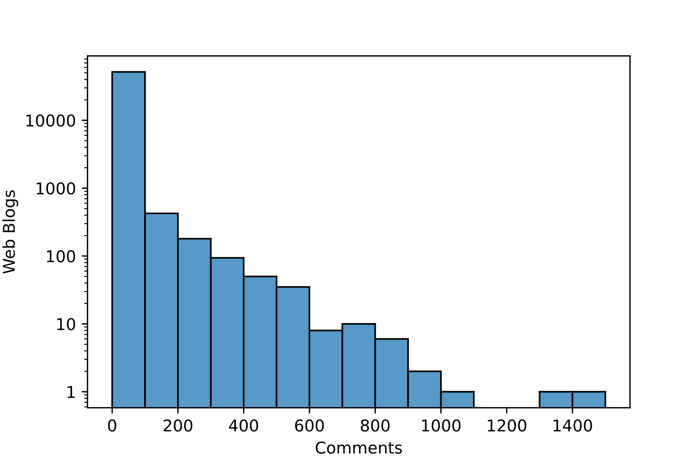
Buying power of marketing spend
More than half (64%!) of the blogs are “Junk Blogs” with zero reply activity within the following 24 hours.
Early identification, within 24 hours, of ‘junk’ channels could result in savings of up to 64% of a budget for that day.
Exponentially decreasing number of blogs with increasing ‘quality’.
Junk Blogs
Quality Blogs
Rock star blogs
Notes:
There are 33559 blogs with 0 comment activity
5775 with 1 comment activity
2820 with 2 comments.

Slide 4
Rock Star Blogs
We can turn the problem around and try to identify ‘Rock Star’ blogs.
Suggests a different strategy of not spending anything unless we see signs of activity.
Exponentially decreasing number of blogs with increasing ‘quality’.
Junk Blogs
Quality Blogs
Rock star blogs

Slide 5

Does it generate clicks? Conversion? ROI?
The assumption that no comment activity signifies a ‘junk blog’ is likely reasonable.
The assumption that blogs with only 1, 2, 3,… replies are not ‘junk blogs’ is likely un-reasonable.
Does post activity indicate a large amount of traffic for a particular post? Or is posting activity more relevant than traffic for generating conversions?
Data Science and Marketing division must collaborate to establish this link.

Slide 6
Final Comments & Recommendations
Currently the value of identifying ‘junk blogs’ is dependent on augmenting already existing or planned marketing campaigns targeting web blogs.
Data Science & Marketing division need to collaborate on quantifying connection between activity and objectives, and identifying upcoming web blog marketing campaigns.
The data has been useful to show a proof-of-concept model which can identify junk blogs. >65%

Slide 7
Key Highlights
First ML Prototype models give positive but modest results [88% “Junk blog”, 62% “quality blog ” identification accuracy.]
24 hour detection of “junk weblogs” could result in savings as large as 64% of a daily marketing budget, with an optimised model.
The relationship between commentary, traffic, conversion, ROI, reach, views, or brand awareness is unclear. Needs to be established before more optimisation efforts become valuable.
Preliminary results from prototype post predictors show an important factor to prediction is overall blog activity. i.e. Is the post hosted on a ‘popular’ blog?
Notes:
Assumptions

Slide 8
Model Insights
Strongest predictors of the number of comments are whether all the posts on the blog are collectively active.
i.e. Is the post hosted on a currently active blog.
There are post “Bag of words” features, key word groupings, perhaps, more useful when interacting with the above features.

Slide 9
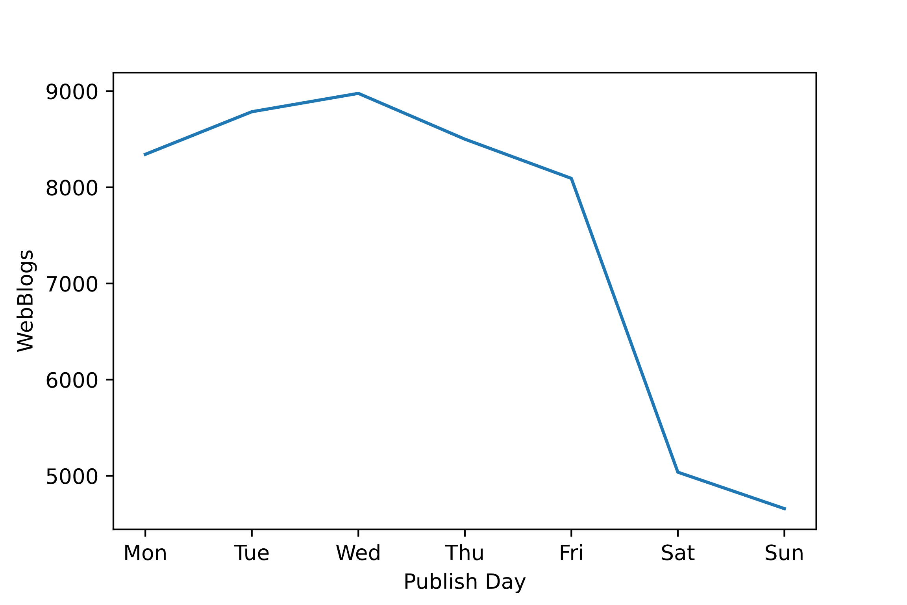
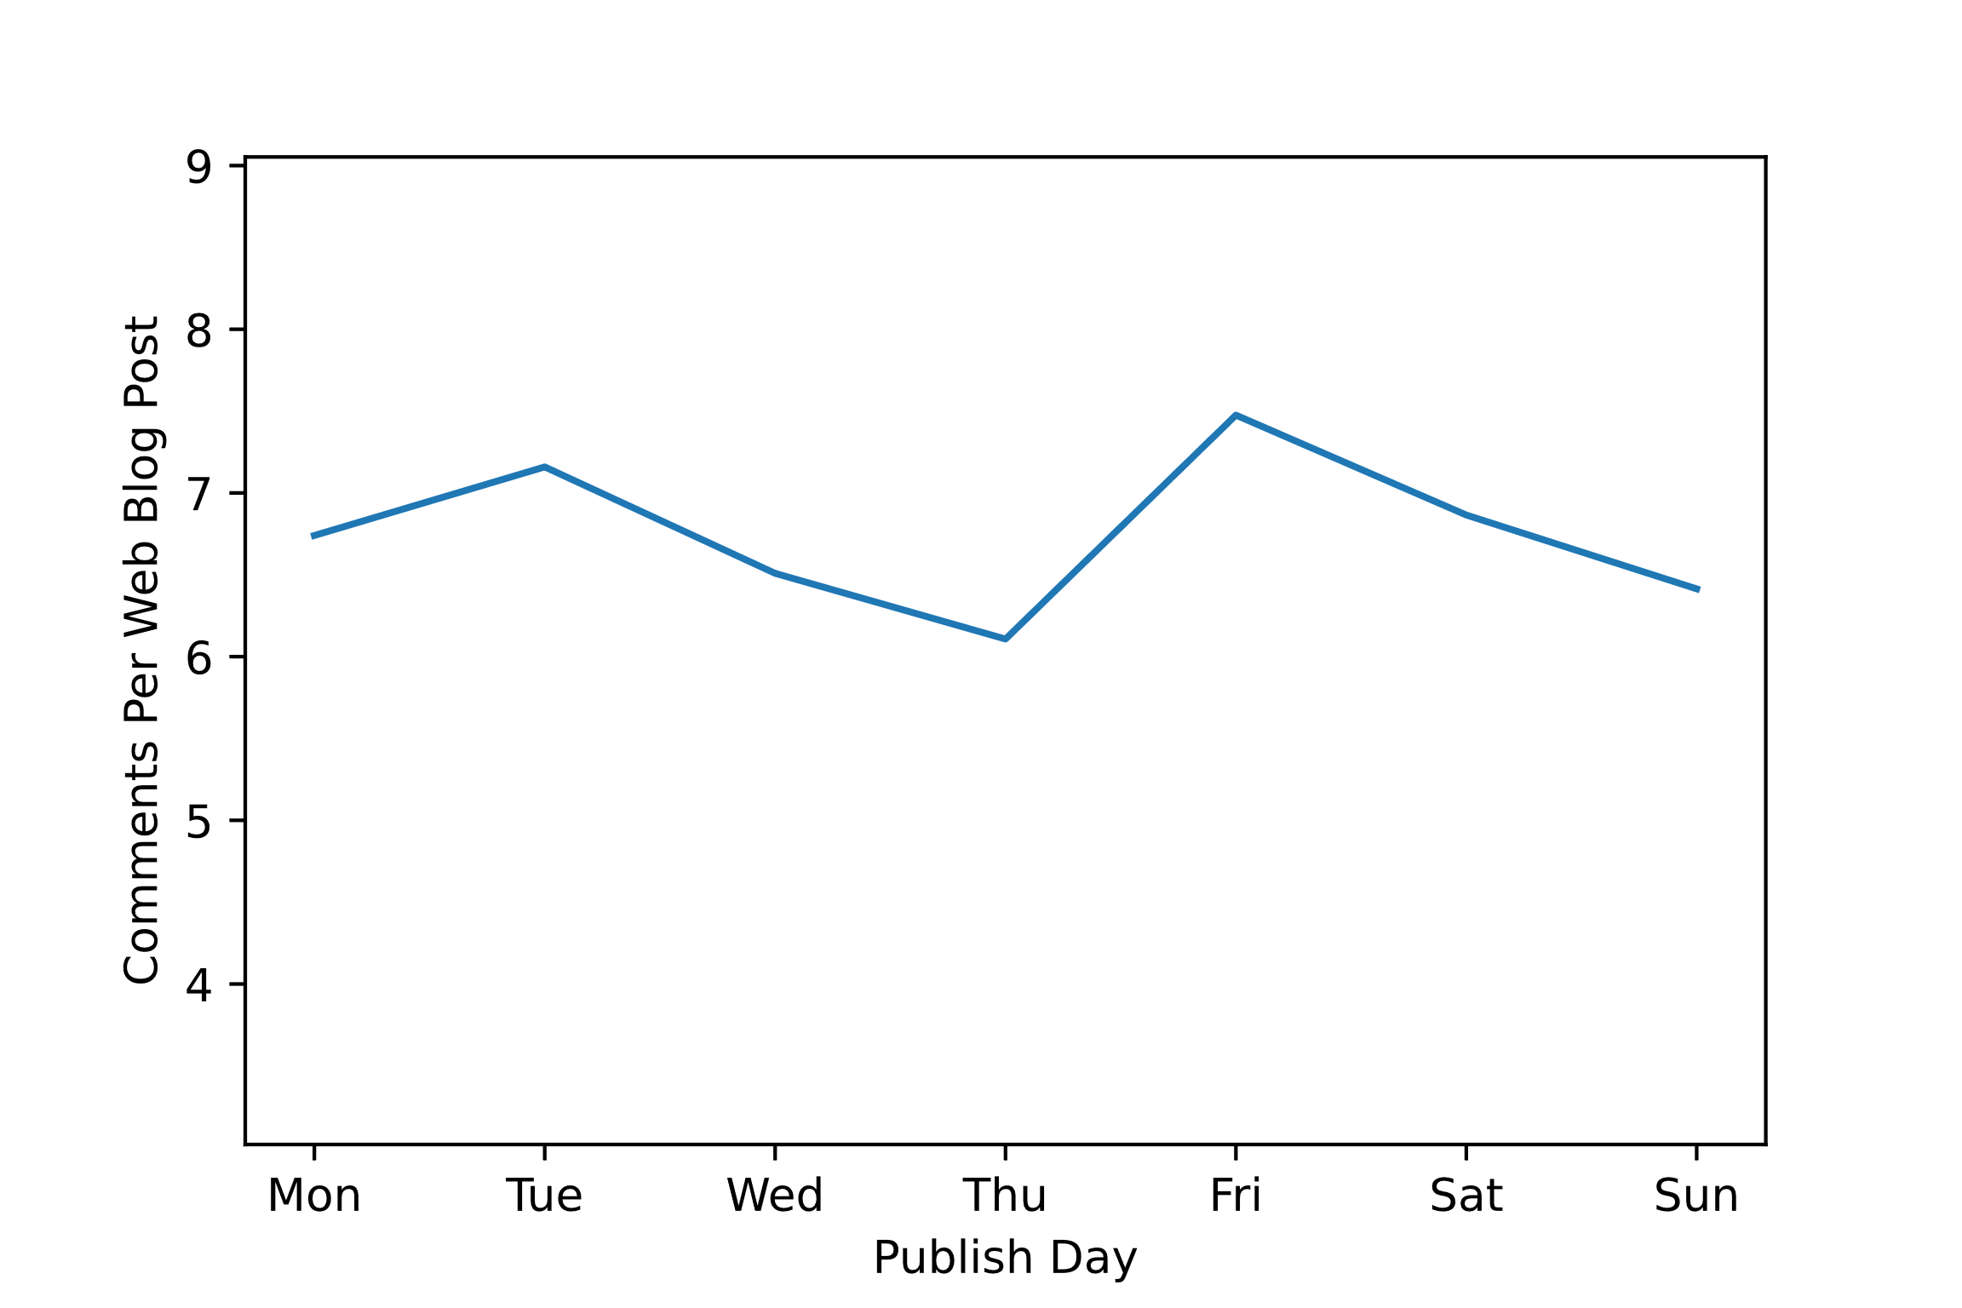
Model Insights
Blogs are published mostly on weekdays.
But replies per post might be independent of publish day.

